Slide 1
Introduction to Machine Learning

Slide 2
Scikit-learn module

Slide 3
Scikit-learn module
Scikit-learn is a library in Python that provides many supervised learning and unsupervised algorithms. It is built upon some of the packages you already familiar with, like NumPy, Pandas, and Matplotlib. With Scikit-learn module, you can train different machine learning models such as regression and classification and check their performance using any of the metrics discussed in unit 2.

Slide 4
Scikit-learn module
The functionality that scikit-learn provides include:
Preprocessing
Regression
Classification
Clustering
Model selection

Slide 5
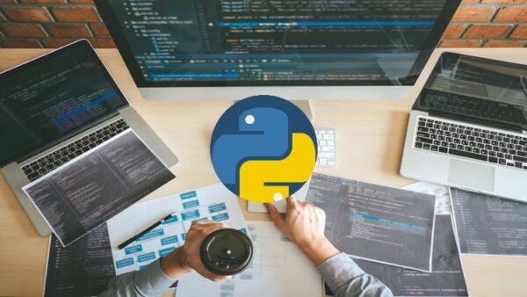
Lab session
Open machine learning classification
Jupyter Notebook

